Slide 1
Chapter 6
Queue

Slide 2
QUEUE
A queue is an ordered collection of items for which we can only add an item at the back or remove an item from the front.
Queue is a linear data structure where the first element is inserted from one end called REAR and deleted from the other end called as FRONT.
It operates on FIFO (first in first out) basis
The queue is yet another data structure, much like a stack, but with a much more limited set of operations.
Types of queue
Linear Queue
Circular Queue

Slide 3
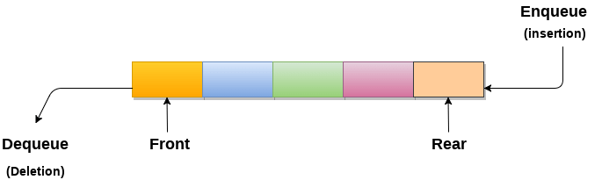



Queue Operations
It has two operations
Enqueue: adding data at the end of the list
Dequeue: deleting data at the head of the list
Eg. Enqueue(c)
Enqueue (B)
Enqueue(A)
Dequeue()
Enqueue(D)
Dequeue()
C | B| A
| B| A
| B| A| D
A|D

Slide 4
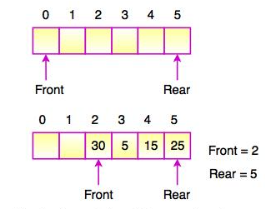
Simple array implementation of enqueue and dequeue
Analysis – consider the following structure
int num[max-size];
We need the following variables
int rear=-1, front=-1, queuesize=0;

Slide 5
To enqueue
Check if there is space
Queuesize<max-size or //rear< max-size?
Yes: queuesize==0?
Yes: increment front
No: Increment rear and queuesize, Store the data in data in num[rear]
No: queue overflow

Slide 6
To dequeue
Check if there is data
Queuesize>0?
Yes:
Copy the data in num[front]
Increment front
Decrement queuesize
No: queue underflow

Slide 7
Example
Enqueue(5) →5
Enqueue(7) →5,7
Enqueue(4) →5,7,4
Dequeue() →7,4
Enqueue(2) →7,4,2
F
R
|7|4|2

Slide 8
Exercise
Write a simple array implementation of queue data structure ( including the operations enqueue, dequeue, isempty, isfull, an so on)

Slide 9
Circular queue
Rear of the queue is somewhere clockwise from the front.
To enqueue an element, we move rear one position clockwise and write the element in that position .
To dequeue, we simply move front one position clockwise .
Queue migrates in a clockwise direction as we enqueue and dequeue.
emptiness and fullness to be checked carefully.

Slide 10
Array implementation of Circular Queue
Limitation of simple array implementation is, as we keep on dequeueing an element from the array, front may exceed maxsize, while we have some free spaces
E.g num[5]
dequeue(), dequeue(), dequeue(), dequeue(), dequeue(),
Enqueue(3) impossible
F
R
5 | 7 | 6 | 11 | 8
R
F
| | | |

Slide 11
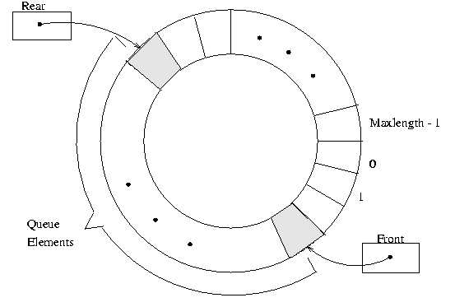
Array implementation of Circular queue

Slide 12
To enqueue
Check if there is space
Quesize<max-size??
Yes:
Queuesize==0??
Yes: increment front
Increment rear and queuesize
Rear==maxsize??
Yes: rear=0
Store the data in num[rear]
No: queue overflow

Slide 13
To dequeue
Check if there is data
Queuesize>0???
Yes:
Copy the data in num[front]
Increment front
Front==max-size??
Yes:Front=0;
Decrement queuesize
No: queue underflow

Slide 14
Exercise
Write the array implementation of circular queue data structure

Slide 15
Linked List Implementation of enqueue and dequeue
Enqueue – inserting node at the end of the list.
Dequeue – deleting the first node in the list.
Implementation – exercise, just see the linked list adding at the end and deleting at the start example from the previous chapter

Slide 16
Different types of queue
Deque:
is also double ended queue
Insertion and deletion are possible at both ends
Implementation are the same as that of queue
Is best implemented by double linked list
Implementation: exercise

Slide 17
Priority queue
In priority queues, elements arrive in an arbitrary order, but are enqueued with information about their priority.
It is a queue where each element has an associated key value at the time of insertion.

Slide 18
E.g.
Original queue
Female Queue
Male Queue
Sara Solomon Ahmed Meron Abiy saba
F M M F M F
Sara Meron Saba
Solomon Ahmed Abiy

Slide 19
Continued….
While (original queue is not empty)
{
Data=dequeueOriginalQueue();
If(gender of data is male)
Enqueue male queue(data);
Else
Enqueue Female queue(data)
}

Slide 20
To create priority queue
While (female queue is not empty)
Enqueue to priority queue (dequeue female queue())
While (males queue is not empty)
Enqueue to priority queue
Priority queue
Sara Meron saba Solomon Ahmed Abiy
F F F M M M

Slide 21
e.g.2
The data with the largest element with higher priority
Dequeue() A will be selected
Dequeue() B >>
Dequeue() C >>
Dequeue() D >>
A B C F E D H
40 30 25 15 18 20 12

Slide 22
Exercise
Write a program that merges two priority queues, sorted in ascending order of priority, to create a single queue.
E.g
A C D F
40 25 20 15
A B C D E F H G
40 30 25 20 18 15 12 10
B E H G
30 18 12 10

Slide 23
Application of Queue
1. printserver
Print()
{
Enqueue printqueue(document)
}
End_of_print()
{
Dequeue printqueue()
}
Document1.doc letter.doc assign.cpp

Slide 24
Application of queue
2. disk driver, the one first inserted will have first letter (eg. A:, B:, C:, D:, E…
3. Task scheduler in multiprocessing system
Eg. Printing 16, searching 5, browsing 17, opening 7

Slide 25
Application of queue
4. telephone calls in a busy environment
5. simulation of waiting line
Line in a supermarket
Line at cafeteria, bank and so on…

Slide 26
…
???
End!!!!!!!!

